Slide 1
Angular (Version 4)

Slide 2
Introduction of Angular 4

Slide 3
Introduction of Angular 4
Our Introduction to Angular 4 introduces everything you need to know to get started with this next generation of the Angular framework. Angular 4 makes the creation of single page applications even easier that before.
In this course developers will learn to use Angular Directives and to create Angular Components and Services to develop applications based on the Model-View-Controller (MVC) architecture.
You will learn to use HTML Templates to define views and to connect views with code using output, two-way, event and property bindings.

Slide 4
Introduction of Angular 4 ……
The course reviews the benefits and challenges of Single Page Applications and how to overcome those challenges using the Angular Router.
The course also covers everything you need to know about Typescript - a programming language based on JavaScript that is used to create Angular 4 applications.

Slide 5
Need of Angular 4

Slide 6
Need of Angular 4
AngularJS is one of the most popular JavaScript frameworks for creating and managing Web applications.
The latest upgrade to this framework was Angular 4 with major improvements and added functionality.
Angular 4 has adopted Semantic Versioning and is backward compatible with Angular 2 for most applications. Angular 4 offers major upgrades over the previous releases.

Slide 7
Need of Angular 4 ……
It makes the Angular app smaller and faster by reducing the size of the production code and simplifies the development of Angular applications.
Furthermore, Angular 4 is backward compatible with Angular 2 and it also provides additional directives and services.

Slide 8
Concept of Angular 4

Slide 9
Concept of Angular 4
The Angular 4 is a development platform for building web, mobile, and desktop applications. It is based on web standards to make web development simpler and more efficient, and entirely different from the Angular JS 1.x.
The architecture of Angular 4 builds on top of the web component standard so that we can define custom HTML selectors and program behavior for them.
The Angular team develops Angular 2 to use in the ECMAScript 2015, TypeScript, and Dart languages.

Slide 10
Concept of Angular 4 ……
Building blocks of Angular 4
Any web application built on Angular 4 consist of:
HTML templates with Angular-specific markup
Directives and components managing the HTML templates
Services containing application logic
Special bootstrap function which helps to load and start the Angular application

Slide 11
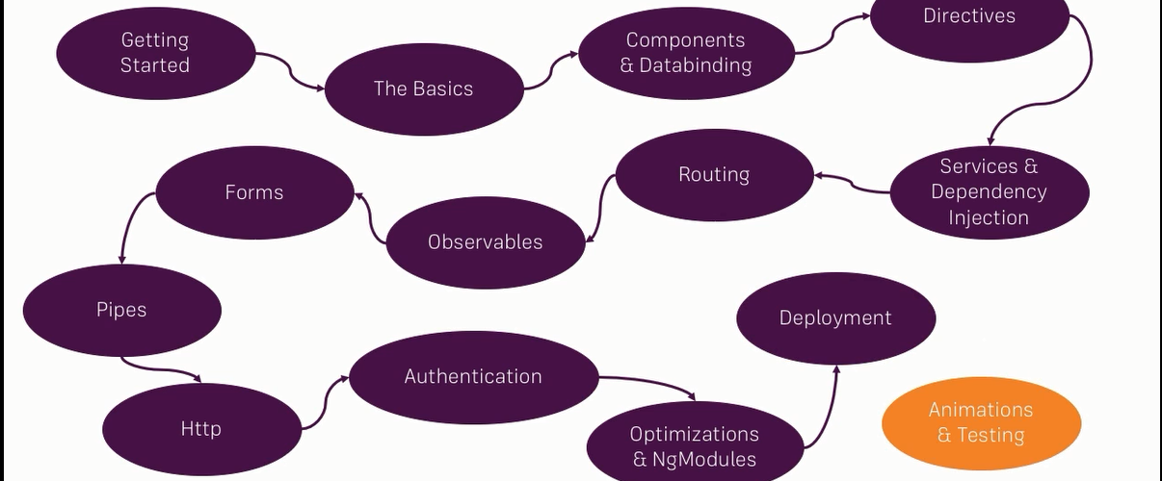
Course Structure

Slide 12
Angular 4
CLASSROOM TRAINING

Slide 13

Week 1
First Angular 4 Application
Binding Data to Components
Directives
Introduction to TypeScript
-- Using Annotations and Types

Slide 14
Week 2
Angular 4 Concepts - How Angular Works
Components, Controllers, and Views
Using the Built-in Components
Forms and Validations

Slide 15
Week 3
Understanding Observables and RxJS
Data Architecture with Observables and RxJS
Data Architecture With Redux and Angular
Intermediate Redux with Angular
Pipes

Slide 16
Week 4
Dependency Injection and Services
Working with APIs and HTTP
Routing
Authentication

Slide 17
Week 5
Hybrid Apps: Porting An Angular 1 App to Angular 4
Writing Advanced Components
-- Optimization & NgModules

Slide 18
Week 6
Understanding Lifecycle Hooks
Project Work
Deployment
Introduction of Animation & Testing

Slide 19
Week 7
Interview & Certification
Interview
Questionnaire
Resume Preparation
Certification
Preparation
test
+
+

Slide 20

Project
The whole last week is dedicated to project work.
Project type choose in such a way that all the topics studied under the course will be covered.

